Slide 1

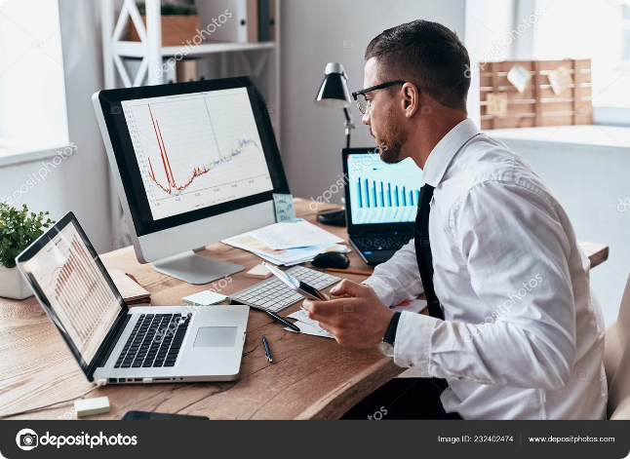
Effective Email Writing: Dos & Don'ts
Crafting professional emails is crucial for effective communication in today's workplace. By adhering to certain dos and don'ts, you can ensure that your emails are clear, concise, and impactful.

Slide 2
Dos: Clarity and Conciseness
Short Sentences
Focused Paragraphs
Direct Language
Keep sentences under 15 words. Avoid complex sentence structures.
Each paragraph should address a single point. Limit paragraphs to 3-4 sentences.
Use strong verbs and avoid passive voice whenever possible.

Slide 3

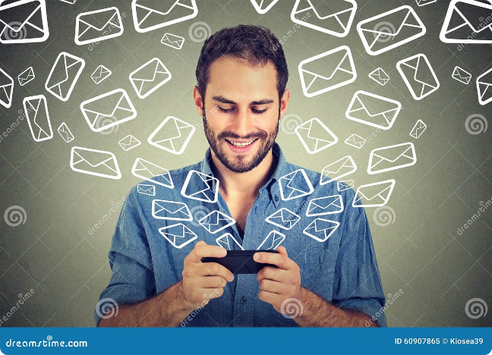
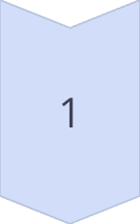
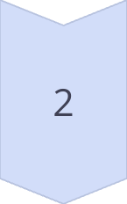
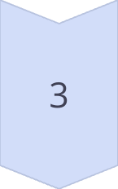
Dos: Proper Salutation and Greeting
Formal Greeting
Use "Dear [Name]" or "To Whom It May Concern" for formal emails.
Professional Closing
End with "Sincerely," "Regards," or "Best Regards."
Follow Up
If needed, include a brief statement about next steps or follow-up actions.

Slide 4

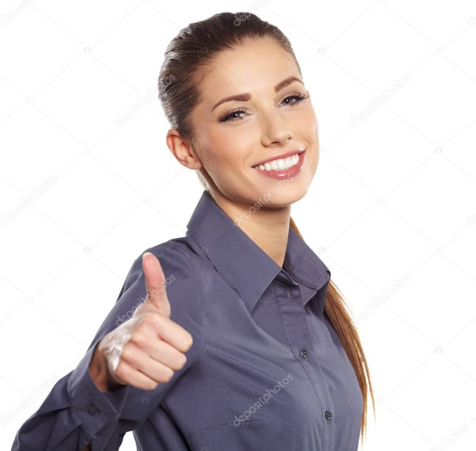
Dos: Attention to Tone and Voice
Positive Language
Respectful Tone
Use positive and upbeat language to build rapport and foster a collaborative tone.
Avoid overly familiar language or informal expressions, even with colleagues.
Clear and Concise
Use simple language and avoid jargon or technical terms that your recipient might not understand.

Slide 5
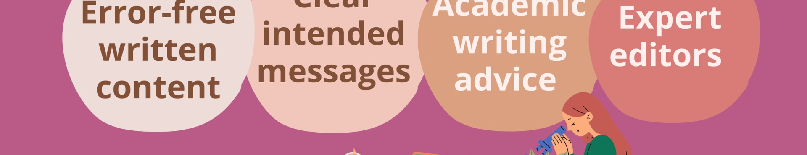
Dos: Proofreading and Editing
Spelling and Grammar
Check for typos and grammatical errors.
Clarity and Conciseness
Ensure your message is easy to understand and avoids unnecessary words.
Tone and Style
Review your email for appropriate tone and ensure it aligns with your professional image.

Slide 6

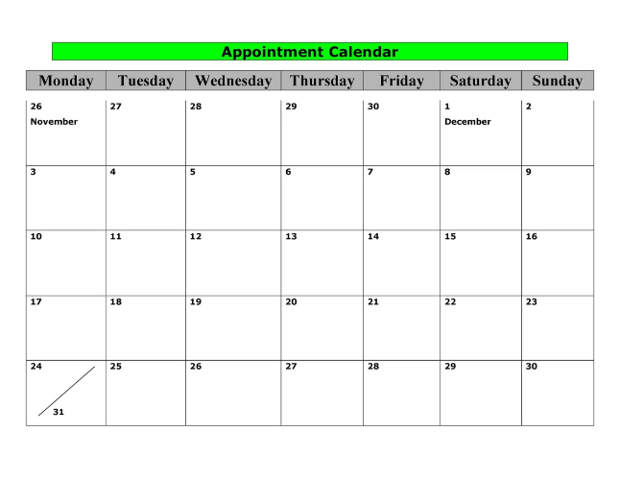

Dos: Timely Responses
1
Prompt Response
Reply to emails within 24 hours whenever possible.
2
Acknowledge Receipt
If you can't respond immediately, acknowledge receipt and provide an estimated time frame.
3
Clear Communication
Keep the recipient informed about any delays or changes in response times.

Slide 7

Dos: Closing (expressions for thinking)
Thank you for your help. / time / assistance / support
I really appreciate the help. / time / assistance
/ support you‘ve given me.
Thank you once more for your help in this matter

Slide 8
Let’s make the improvements required
Subject: Need information
Hi John,
I hope you're doing well. I wanted to ask if you could send me the details about
the project we discussed last week. I need them as soon as possible because
I have to prepare a report for the meeting next week. Let me know if you have
any questions.
Thanks.
Regards,
Jane

Slide 9
ANSWER
Subject: Request for Project Details for Upcoming Meeting
Hi John,
I hope you’re doing well.
Could you please send me the details about the project we discussed last week?
I need this information to prepare a report for our meeting scheduled for next week on August 10th.
If you have any questions or need further clarification, please feel free to reach out. Your assistance
with this is greatly appreciated.
Thank you very much for your help.
Best regards,
Jane

Slide 10
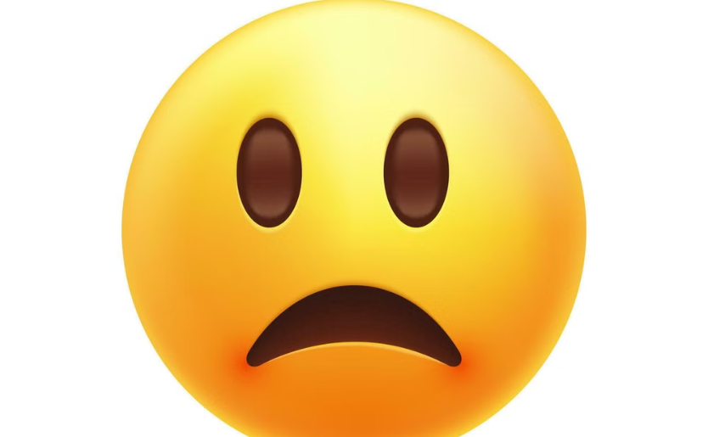
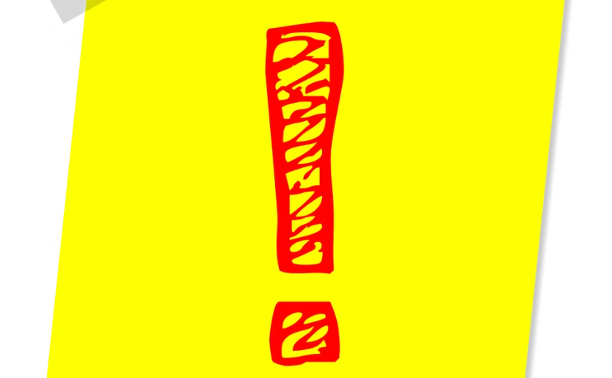
Don'ts: Overly Casual Language
Slang and Acronyms
Emojis and GIFs
Avoid using slang or informal language, as it may come across as unprofessional.
Use emojis sparingly and avoid using GIFs unless they are relevant and appropriate for the context of the email.

Slide 11
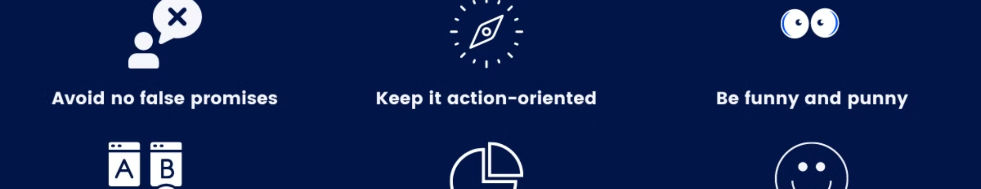



Don'ts: Lengthy or Rambling Messages
Time is Valuable
Focused Content
Proofread Carefully
Respect your recipient's time by keeping emails concise and to the point.
Ensure each email has a clear purpose and focus. Avoid including unrelated information.
Avoid long paragraphs and ensure your message is easy to read and understand.

Slide 12

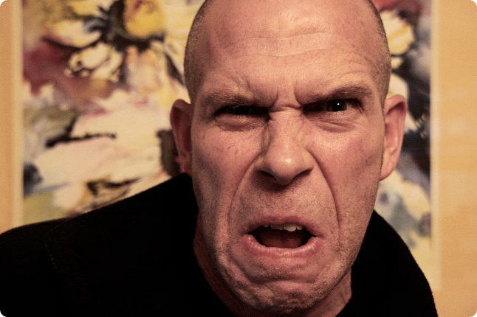
Don'ts: Emotional or Confrontational Tone
1
Stay Professional
2
Be Respectful
Avoid expressing anger or frustration in your emails.
Treat others with respect, even when disagreeing with them.
3
Focus on Solutions
If a conflict arises, aim to find a solution rather than placing blame.

Slide 13
Choose the appropriate option:
Which of the following is considered a poor practice when composing an email?
A) Using a clear subject line
B) Including a polite greeting
C) Using abbreviations and slang
D) Proofreading before sending

Slide 14
Choose the appropriate option:
Which of the following is considered a poor practice when composing an email?
A) Using a clear subject line
B) Including a polite greeting
C) Using abbreviations and slang
D) Proofreading before sending
Answer: C) Using abbreviations and slang

Slide 15
Choose the appropriate answer:
What is the best way to begin an email to a new client?
A) "Hey there!"
B) "To whom it may concern"
C) "Dear [Client's Name],"
D) "Yo!"

Slide 16
Choose the appropriate answer:
What is the best way to begin an email to a new client?
A) "Hey there!"
B) "To whom it may concern"
C) "Dear [Client's Name],"
D) "Yo!“
Answer: C) "Dear [Client's Name],"

Slide 17
Choose the appropriate answer:
Why is it important to proofread an email before sending it?
A) To ensure it is as long as possible
B) To identify and correct spelling and grammatical errors
C) To make it more informal
D) To add more emojis

Slide 18
Choose the appropriate answer:
Why is it important to proofread an email before sending it?
A) To ensure it is as long as possible
B) To identify and correct spelling and grammatical errors
C) To make it more informal
D) To add more emojis
Answer: B) To identify and correct spelling and grammatical errors

Slide 19

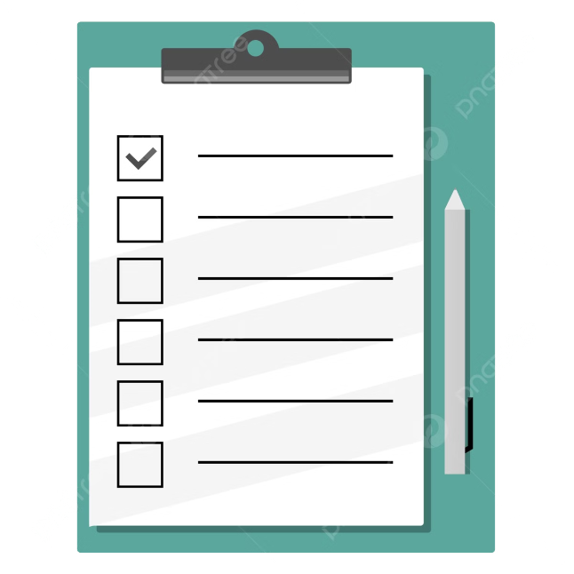
Dos: Key Takeaways
1
Concise
2
Clear
Focus on the essential points. Avoid unnecessary details.
Use simple language and avoid jargon. Structure your thoughts logically.
3
Professional
4
Actionable
Maintain a formal tone and avoid slang. Proofread carefully for errors.
State your purpose and include a clear call to action.

Slide 20
